Slide 1














AWS Security Monitoring
Security Account
TNC Account
Logging Account
AWS CloudTrail
AWS Config
Logging Archive
S3://App/Account#
Amazon GuardDuty
Core Account
S3://App/Account#
SQS
Subscribes to SNS Topic
Splunk Heavy Forwarder EC2
AWS CloudTrail
AWS Config
Amazon GuardDuty
SNS Service
Topic on S3
App Account
AWS CloudTrail
AWS Config
Splunk Cloud ELB/ALB
AWS GuardDuty

Slide 2


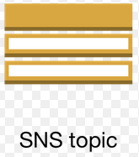
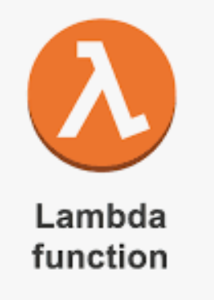
AWS Security Monitoring
Splunk Cloud ELB/ALB
Security Account
TNC Account
Logging Account
US-WEST-2
AWS CloudTrail
AWS Config
Logging Archive
Splunk Heavy Forwarder EC2
S3://App/Account#
Amazon GuardDuty
Ec2 –status change
Core Account
SQS
Subscribes to SNS Topic
Lambda invoke
Ec2 turn on function
S3://App/Account#
AWS CloudTrail
AWS Config
Amazon GuardDuty
US-EAST-1
Ec2 turn off function
SNS Service
Topic on S3
App Account
AWS CloudTrail
AWS Config
Ec2 turn off function
Ec2 turn ON function
SQS
Subscribes to SNS Topic
Splunk Heavy Forwarder EC2
AWS GuardDuty

